Slide 1
Ensemble Machine Learning Analysis on Stroke Data
Group 1
Saaketh Vummalaneni, Lauren Koval, Liyuan Zhou, Liana Manuel

Slide 2
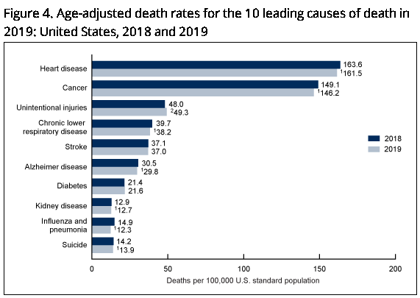
Background
2nd leading cause of death worldwide; 5th leading cause in the U.S.¹
Risk factors include history of hypertension, smoking, diabetes, high cholesterol, and excessive alcohol consumption ²
Existing literature on machine learning and stroke research uses support vector machines, random forests and deep learning
The top 10 causes of death. (2020, December 9). World Health Organization. https://www.who.int/news-room/fact-sheets/detail/the-top-10-causes-of-death
Notes:
1: (The top 10 causes of death, 2020)
2: (George et al, 2017)

Slide 3
Variables
Outcome: stroke
Predictors: age, heart disease, hypertension, marital status, average glucose level, BMI, gender, self-employment, rural, smoking status
Revised smoking status to combine “formerly smoked” and “smokes” vs “never smoked”
The employment variables originally included 5 job options

Slide 4
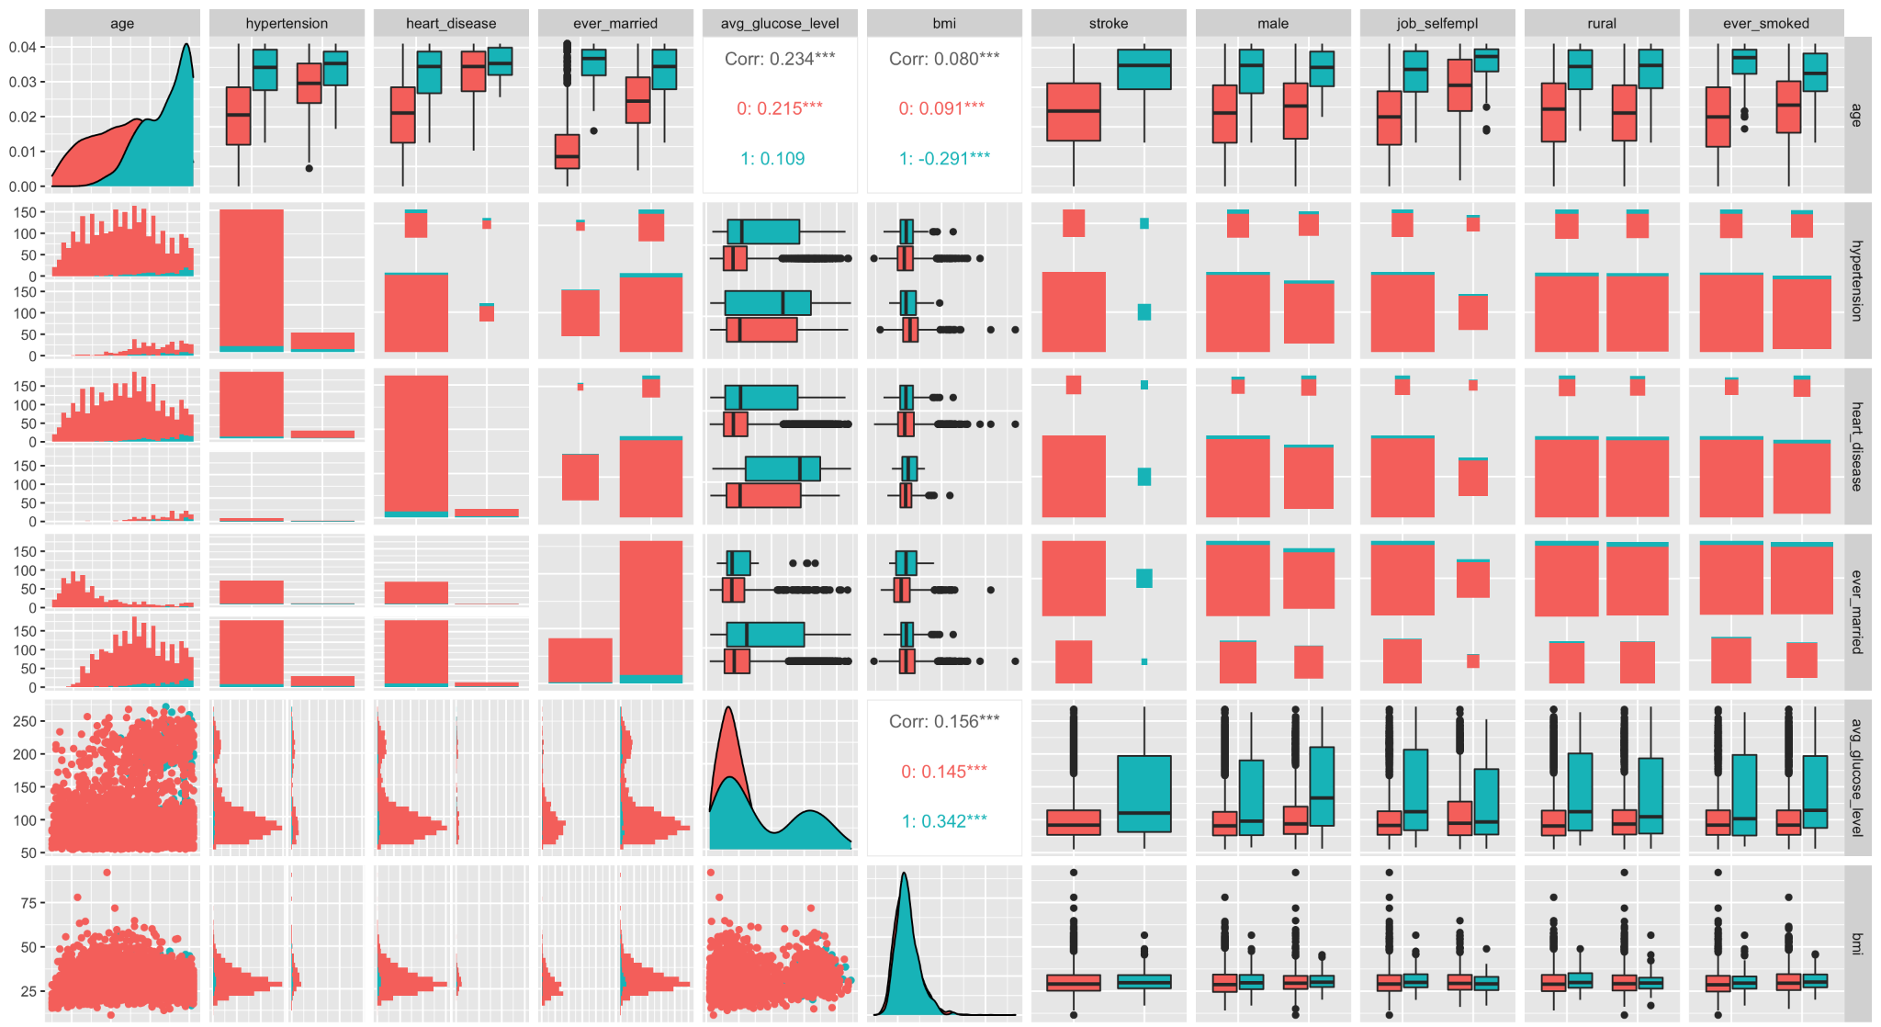
Notes:
Blue indicates the stroke group

Slide 5
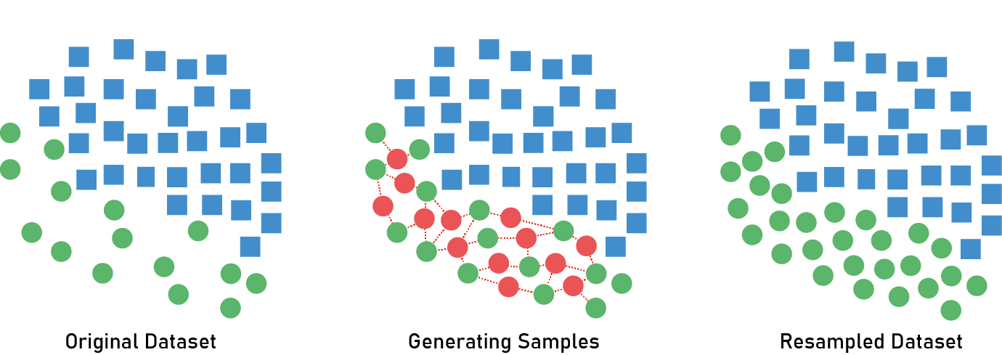
SMOTE
Significant imbalance between majority (no stroke) and minority (stroke) class
~5% of observations were considered to be in the minority class
Used SMOTE and undersampling method
https://heartbeat.fritz.ai/resampling-to-properly-handle-imbalanced-datasets-in-machine-learning-64d82c16ceaa

Slide 6
Models
Logistic Regression
0.5 threshold
Random Forest
ntrees: 50, 250, 500 and 750
predictors: 3.16, 5, 6.32, and 10 predictors (sqrt(p), p/2, 2*sqrt(p), and p)
KNN
tune length of 5
SVM
linear kernel
gamma: 0.001, 0.05 and 0.1
cost: 1,2,3,4,5
epsilon: 0.1, 0.2, 0.3, 0.4, 0.5

Slide 7
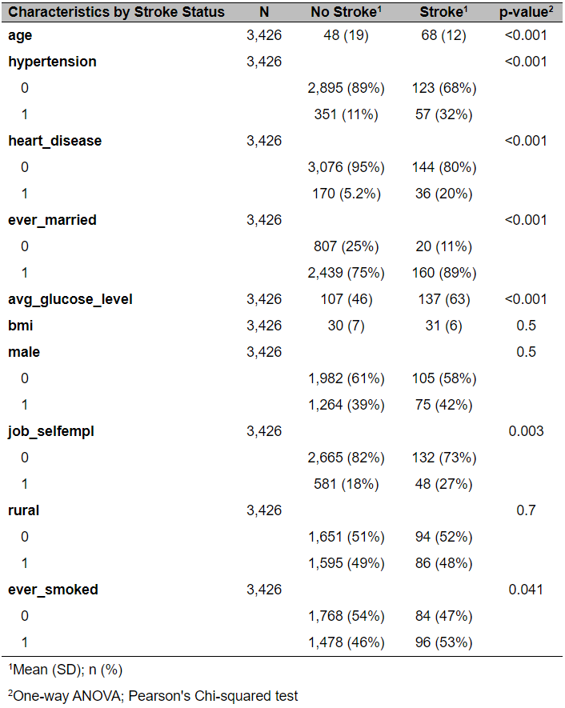
Results
3,426 observations total after exclusion of missing data.
Ages range from 10 to 82 years old.
Participants who were older, had heart disease, higher glucose level, hypertension, and smoked had higher rates of stroke.

Slide 8
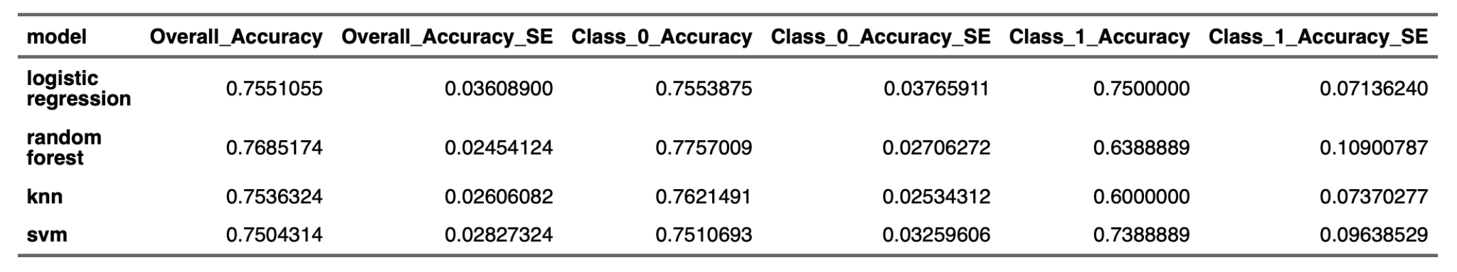
Results
Best performer for stroke classification was the logistic regression model.
Similar overall accuracy and accuracy SE amongst all 4 models with random forest having the highest accuracy.
Biggest difference is in the class 1 accuracy where random forest and kNN perform worse than the other two models.
Logistic regression edges out SVM in both class 0 and class 1 accuracies.

Slide 9
Discussion
Apply various machine learning models to predict the stroke classification and determine which model demonstrated the best performance.
The logistic model is the most straightforward and easiest to utilize.
The independent variables involved in our study are easily accessed so that we can apply our logistic model to a general population with such information.

Slide 10
Discussion
Kaggle did not report specific citation information or further information about the dataset source. As a result, the specific target population is unclear.
BMI is strongly associated with stroke.
Dropping observations with missing BMI leads to a loss of the number of stroke cases.
Missing imputation methods should be considered to impute those missing values to achieve a better prediction performance.
Accuracy is not a really useful metric in the context of strongly imbalanced data. Future studies could consider additional metrics, such as AUC, sensitivity and specificity, rather than just accuracy alone.

Slide 11
Citations
1. The top 10 causes of death. (2020, December 9). World Health Organization. https://www.who.int/news-room/fact-sheets/detail/the-top-10-causes-of-death
2. George, M., Fischer, L., Koroshetz, W., Bushnell, C., Frankel, M., Foltz, J., & Thorpe, P. (2017, May 12). CDC Grand Rounds: Public Health Strategies to Prevent and Treat Strokes. Centers for Disease Control and Prevention.
3. Fedesoriano (2020). Stroke Prediction Dataset. Kaggle. Retrieved from: https://www.kaggle.com/fedesoriano/stroke-prediction-dataset
4. R Core Team (2020). R: A language and environment for statistical computing. R Foundation for Statistical Computing, Vienna, Austria. URL https://www.R-project.org/.
5. Shugalo, I. (2019, May 17). How Artificial Intelligence Can Predict and Detect Stroke. Diagnostic and Interventional Cardiology. https://www.dicardiology.com/article/how-artificial-intelligence-can-predict-and-detect-stroke
6. Siddhesh Sawan (2021). Stroke: EDA + SMOTE + 9 Models (90% Accuracy). Kaggle. Retrieved from: https://www.kaggle.com/docxian/stroke-prediction,
7. Kurth, T., Gaziano, J. M., Berger, K., Kase, C. S., Rexrode, K. M., Cook, N. R., ... & Manson, J. E. (2002). Body mass index and the risk of stroke in men. Archives of internal medicine, 162(22), 2557-2562.
8. Park, J. W., Lee, S. Y., Kim, S. Y., Choe, H., & Jee, S. H. (2008). BMI and stroke risk in Korean women. Obesity, 16(2), 396-401
9. Sirsat, M. S., Fermé, E., & Câmara, J. (2020). Machine learning for brain stroke: A review. Journal of Stroke and Cerebrovascular Diseases, 29(10), 105162. https://doi.org/10.1016/j.jstrokecerebrovasdis.2020.105162

Slide 12
Citations Cont.
1. A. Liaw and M. Wiener (2002). Classification and Regression by randomForest. R News 2(3), 18--22.
2. Barret Schloerke, Di Cook, Joseph Larmarange, Francois Briatte, Moritz Marbach, Edwin Thoen, Amos Elberg and Jason Crowley (2021). GGally: Extension to 'ggplot2'. R package version 2.1.0. https://CRAN.R-project.org/package=GGally
3. Daniel D. Sjoberg, Michael Curry, Margie Hannum, Karissa Whiting and Emily C. Zabor (2021). gtsummary: Presentation-Ready Data Summary and Analytic Result Tables. R package version 1.3.6. https://CRAN.R-project.org/package=gtsummary
4. David Gohel (2021). flextable: Functions for Tabular Reporting. R package version 0.6.2. https://CRAN.R-project.org/package=flextable
5. David Meyer, Evgenia Dimitriadou, Kurt Hornik, Andreas Weingessel and Friedrich Leisch (2020). e1071: Misc Functions of the Department of Statistics, Probability Theory Group (Formerly: E1071), TU Wien. R package version 1.7-4. https://CRAN.R-project.org/package=e1071
6. Max Kuhn (2020). caret: Classification and Regression Training. R package version 6.0-86. https://CRAN.R-project.org/package=caret
7. Torgo, L. (2010). Data Mining with R, learning with case studies Chapman and Hall/CRC. URL:http://www.dcc.fc.up.pt/~ltorgo/DataMiningWithR
8. Wickham et al., (2019). Welcome to the tidyverse. Journal of Open Source Software, 4(43), 1686, https://doi.org/10.21105/joss.01686

Slide 13
Thank you!

